Slide 1
Teen Suicide Prevention
Morgan Phillips, LMSW
Prevention Lead,
Teen Lifeline

Slide 2
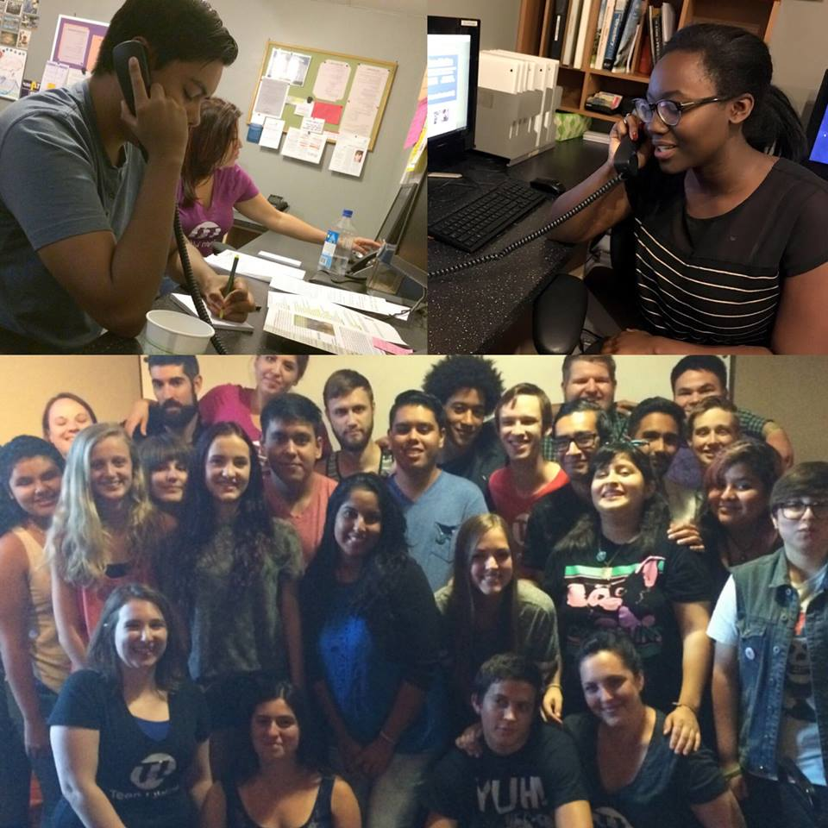
Who Are We?
Hotline
24/7/365
Free, confidential, anonymous
Prevention
Free workshops for youth
Free training for adults
Postvention
eLearning
Crisis management
ID Initiative

Slide 3
The Problem
In Arizona, we lose a teen to suicide every 5.5 days
For every death, there is expected to be 200 attempts
2nd leading cause of death for 10-34 year olds
Youth Risk Behavior Survey (2017)
36.4%- felt sad or hopeless
19.2%- seriously considered attempting suicide
11.2%- attempted suicide

Slide 4
Identifying At-Risk Youth
Mental health symptoms are often misinterpreted
Typical | Not Typical: Cause for Concern
Moodiness | Intense, painful, long-lasting moods, major depression, panic attacks, risky mood dependent behavior, self-injury, or thoughts of suicide
Laziness | Not able to complete tasks, lack of focus that interferes with daily activities, neglectful of basic hygiene
Self-consciousness | Withdrawal, social phobia, binging, purging, or perfectionism
Immaturity | Excessive risk taking, substance abuse, deliberately causing trouble, or school truancy

Slide 5
Risk Factors
Undiagnosed, untreated or ineffective treatment of mental health challenge
Biological factors
Temperament- optimist vs. pessimist, low threshold for stress vs. high threshold for stress
Past history: trauma or suicide
Current life event
Loss (Death, divorce, break up, move etc.)
Drug or alcohol use
Persistent harassment or bullying
Illness of self or family member
Expectations

Slide 6
Warning Signs
Warning Signs
Verbal
Behavioral
Mood
Situational
Observable changes
Signal immediate risk
Individual

Slide 7
Warning Signs: VERBAL STATEMENTS
Direct
Clear and direct statements of feelings, thoughts, and intent.
“I am going to kill myself.”
“I want to die.”
Indirect
Statements alluding to:
Feeling trapped, Unbearable pain, Hopelessness & Helplessness, or Being a burden to others.
“I don’t want to be here anymore.”
“I wish I could disappear.”
“There is nothing left.”

Slide 8
Warning Signs: BEHAVIORAL
Increased alcohol or drug use
Looking for a way to end their life (online searches)
Acting recklessly
Withdrawal from activities
Isolating from friends or family
Sleeping changes/ Eating changes
Increased aggressive behavior/ Lashing out at others
Changes in appearance
Final arrangements
Saying goodbyes
Giving things away

Slide 9
Warning Signs: MOOD
Rage
Irritability
Humiliation
Anxiety
Loss of interest
Depression
Increased sensitivity
Frequent highs and lows

Slide 10
Protective Factors
Overall Resilience
Connectedness with parents and other adults
Achievement
Closeness to caring friends
Safety at school and home
Access to resources

Slide 11
Why Don’t Teens Reach Out?
Teens nor adults who are close to them recognize the symptoms of their treatable illness
Fear of what treatment would involve
Believe nothing can help
The don’t see help-seeking as a sign of strength
They are embarrassed
Believe that adults won’t understand
Are scared of being a burden, disappointment, or anger

Slide 12
What Can Parents Do?

Slide 13
How to Talk to Teens
Watch
Verbal, behavioral, mood or situational warning signs
Ask
Point out the things you are seeing
“I noticed you haven’t been sleeping lately, you don’t go out with your friends, and you have been angry…”
Ask directly about suicide
“Are you thinking about suicide?”
Listen
Be present and take their problems seriously
Avoid giving advice, using clichés, or trying to convince them to live
Get Help
Thank them for having the courage to tell you
Contact your family doctor, a mental health professional, or crisis services

Slide 14
Build Coping Skills
Healthy
Exercise
Video games
Unhealthy
Drugs and alcohol
Spend time with friends
Write
Draw, paint, sketch
Read
Relax
Taking feelings out on others
Isolating
Self-injury
Music

Slide 15
Build Resiliency
Competence
Focus on strengths
Empower teens to make their own decisions
Avoid comparison of siblings
Confidence
Acknowledge individual qualities
Praise a job well done
Avoid unrealistic expectations
Connection
Create a sense of security and safety in the home
Help build connections to healthy adults outside of your home
Character
Teach empathy
Coping
Teach coping skills
Role model
Contribution
Create opportunities for teens to contribute
Control
Teach problem solving skills
Help teens to understand that actions produce outcomes

Slide 16
It Takes a Village
Teen Lifeline: 602-248-TEEN
Crisis Response Network (Mobile Teams): 602-222-9444
National Suicide Prevention Lifeline: 1-800-273-TALK
Quail Run: 602-455-5700
Aurora Behavioral Health Systems: 480-345-5420
La Frontera/EMPACT: 480-784-1514

Slide 17
Questions?
morgan@teenlifeline.org
602-248-8337

